Slide 1
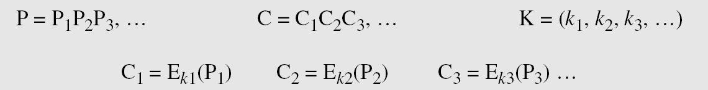
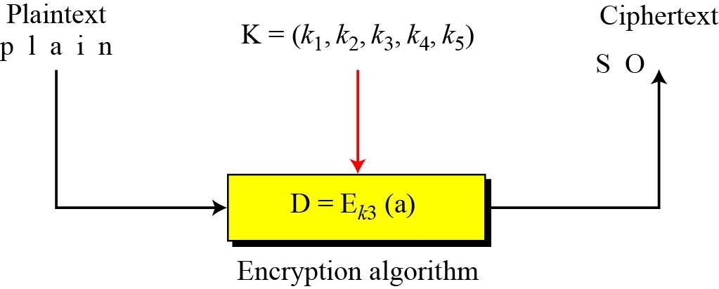
Stream Ciphers
Call the plaintext stream P, the ciphertext stream C, and the key stream K.
Additive ciphers, monoalphabetic ciphers are examples of stream ciphers as they process stream of characters.

Slide 2
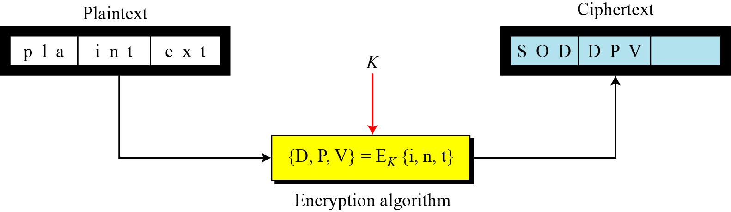
Block Ciphers
In a block cipher, a group of plaintext symbols of size m (m > 1) are encrypted together creating a group of ciphertext of the same size.
A single key is used to encrypt the whole block

Slide 3
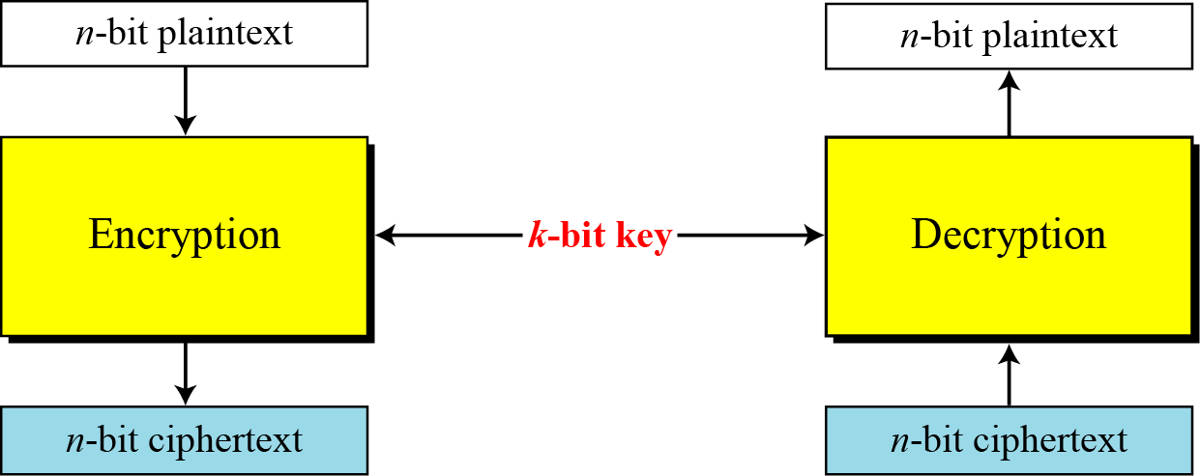
Block cipher
A symmetric-key modern block cipher encrypts an n-bit block of plaintext or decrypts an n-bit block of ciphertext. The encryption or decryption algorithm uses a k-bit key.

Slide 4
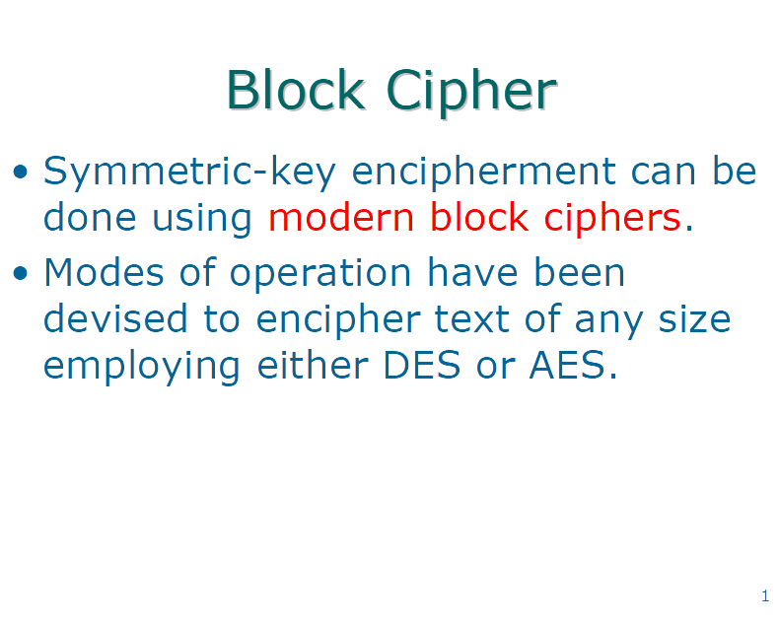

Slide 5
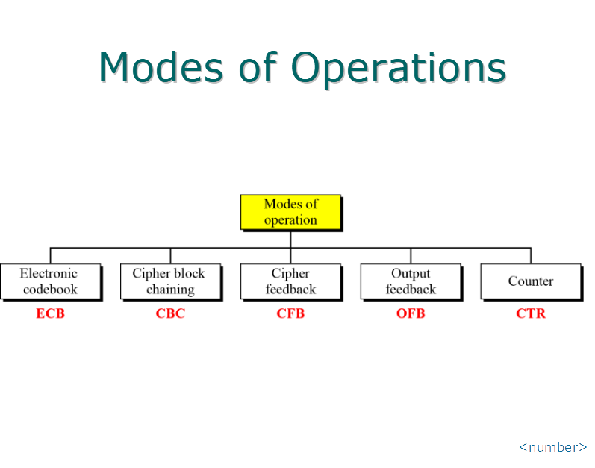

Slide 6
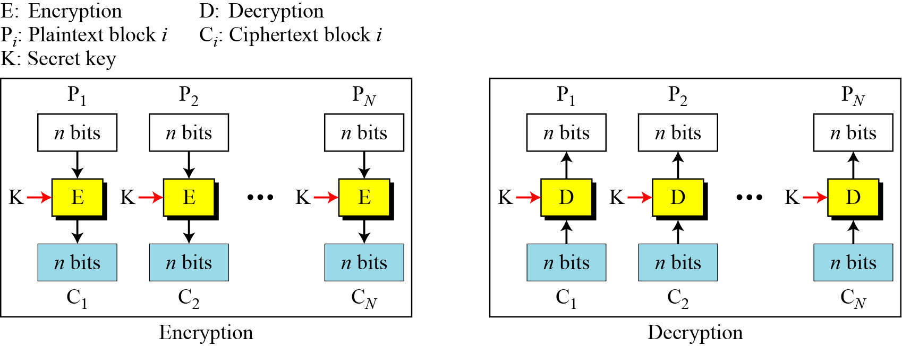
Electronic Codebook Mode (ECB)

Slide 7
Security Issues
Patterns at the block level are preserved. For example, equal blocks in the plaintext become equal blocks in the ciphertext. If Eve finds out that ciphertext blocks 1, 5, and 10 are the same, she knows that plaintext blocks 1, 5, and 10 are the same. This is a leak in security. For example, Eve can do an exhaustive search to decrypt only one of these blocks to find the contents of all of them.
The block independency creates opportunities for Eve to exchange some ciphertext blocks without knowing the key. For example, if she knows that block 8 always conveys some specific information, she can replace this block with the corresponding block in the previously intercepted message.

Slide 8
Error Propagation
A single bit error in transmission can create errors in several in the corresponding block. However, the error does not have any effect on the other blocks.

Slide 9
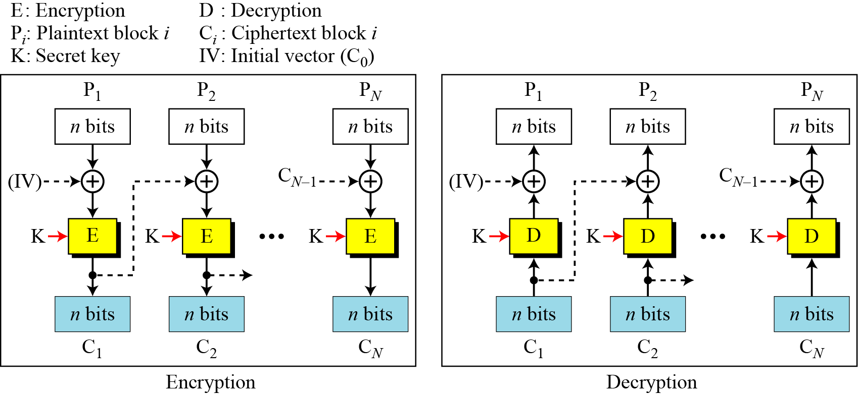
Cipher Block Chaining Mode (CBC)

Slide 10
Initialization Vector (IV)
The initialization vector (IV) should be known by the sender and the receiver. Although keeping the vector secret is not necessary, the integrity of the vector plays an important role in the security of CBC mode; IV should be kept safe from change.
A pseudorandom number can be selected by the sender and transmitted through a secure channel (using ECB mode for example).

Slide 11
Security Issues
In CBC mode, equal plaintext blocks belonging to the same message are enciphered into different ciphertext blocks. In other words, the patterns at the block levels are not preserved. However, if two messages are equal, their encipherment is the same if they use the same IV. As a matter of fact, if the first M blocks in two different messages are equal, they are enciphered into equal blocks unless different IVs are used. For this reason, some people recommend the use of a timestamp as an IV.
Eve can add some ciphertext blocks to the end of the ciphertext stream.

Slide 12
Error Propagation
In CBC mode, a single bit error in ciphertext block C_{j} during transmission may create error in most bits in plaintext block P_{j} during decryption.
However, this single error toggles only one bit in plaintext block P_{j+1} (the bit in the same location).
Plaintext blocks P_{j+2} to P_{N} are not affected by this single bit error. A single bit error in ciphertext is self-recovered.

Slide 13
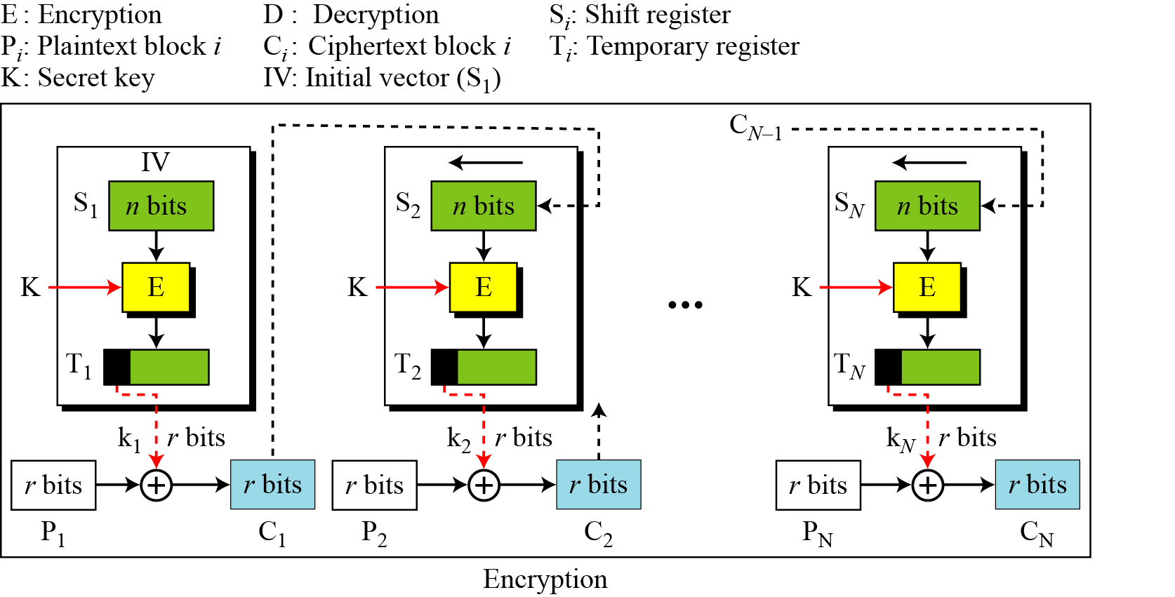
Cipher Feedback Mode (CFB)

Slide 14
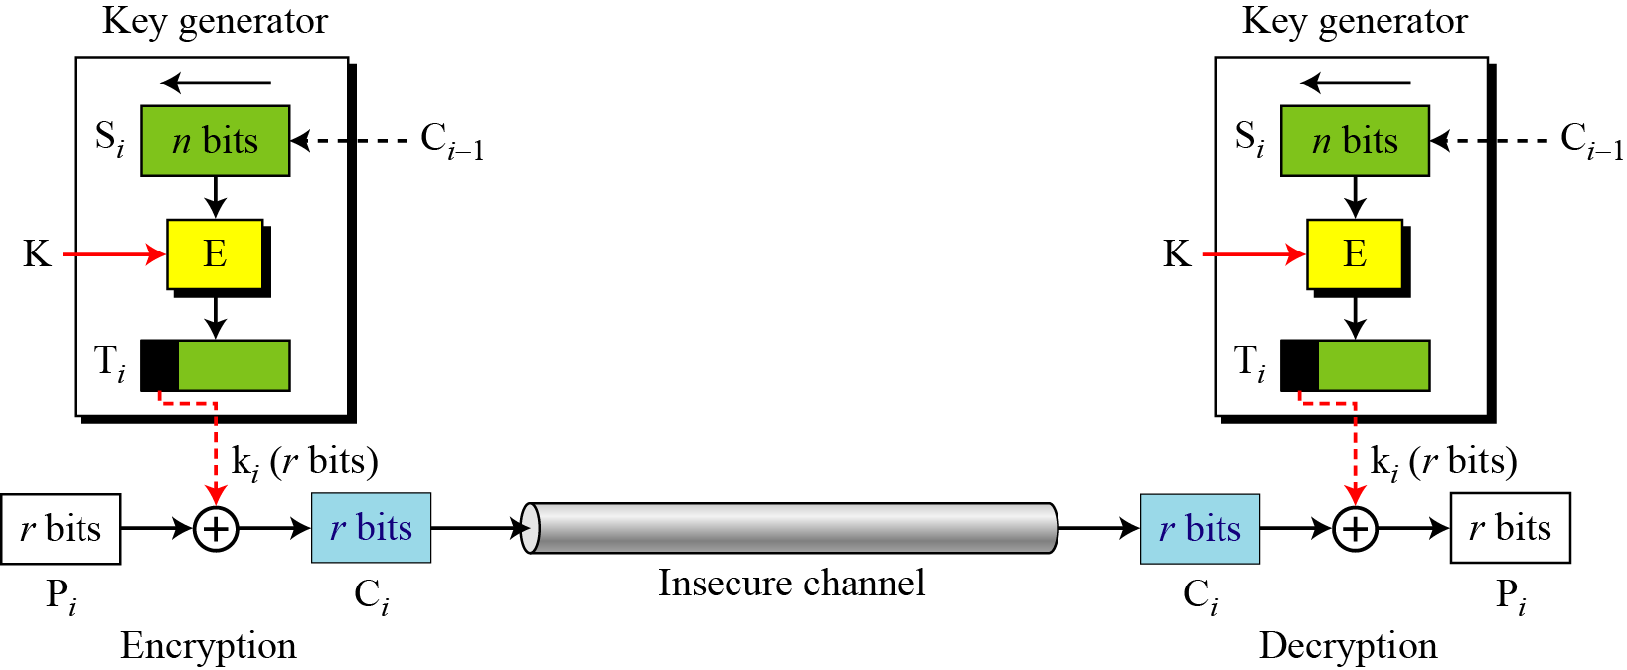
CFB as a Stream Cipher
Although CFB is an operation mode for using block ciphers such as DES or AES, the result is a stream cipher. In fact, it is a nonsynchronous stream cipher in which the key stream is dependent on the ciphertext.

Slide 15
Security Issues
Just like CBC, the patterns at the block level are not preserved.
More than one message can be encrypted with the same key, but the value of the IV should be changed for each message. This means that Alice needs to use a different IV each time she sends a message.
Eve can add some ciphertext block to the end of the ciphertext stream.

Slide 16
Error Propagation
In CFB, a single bit error in ciphertext block C_{j} during transmission creates a single bit error (at the same position) in plaintext block P_{j}.
However, most of the bits in the following plaintext blocks are in error (with 50 percent probability) as long as some bits of C_{j} are still in the shift register.
After the shift register is totally refreshed, the system recovers from the error.

Slide 17
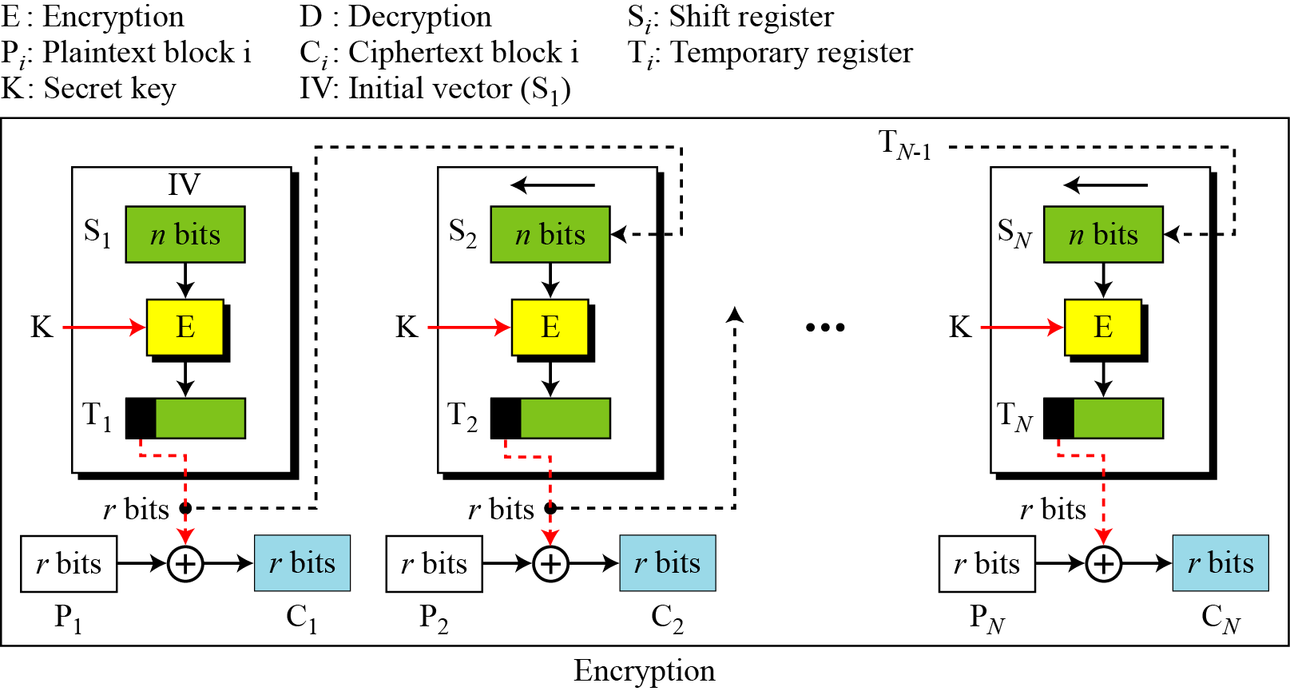
Output Feedback Mode (OFB)

Slide 18
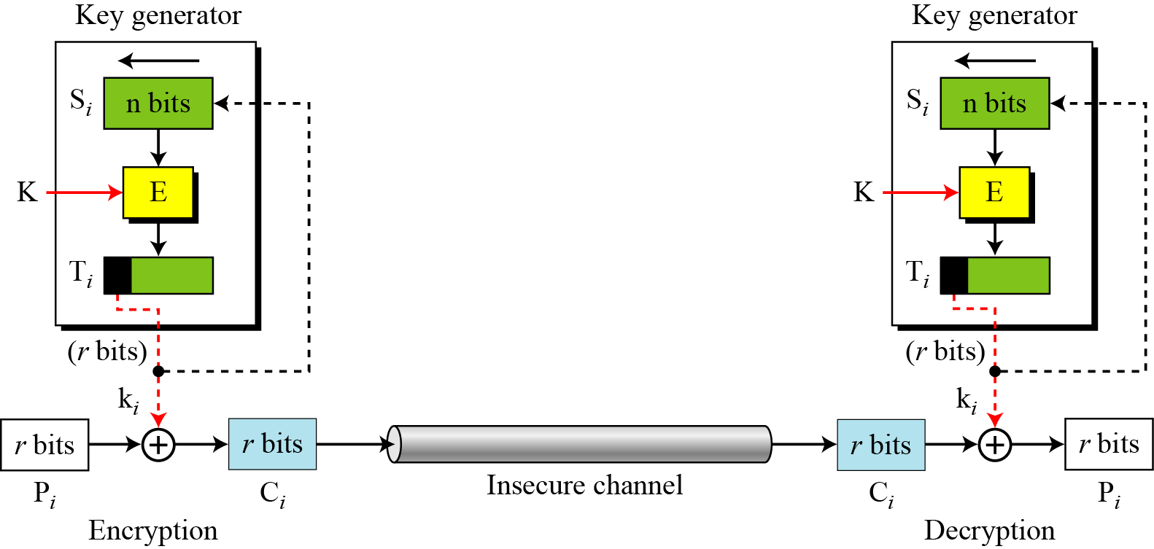
OFB as a Stream Cipher
The keystream, however, is independent from the plaintext or ciphertext, which means that the stream cipher is synchronous.

Slide 19
Security Issues and Error Propagation
Just like the CFB mode, patterns at the block level are not preserved.
Any change in the ciphertext affects the plaintext decrypted at the receiver side.
A single error in the ciphertext block c affects only the corresponding bit in the plaintext.

Slide 20
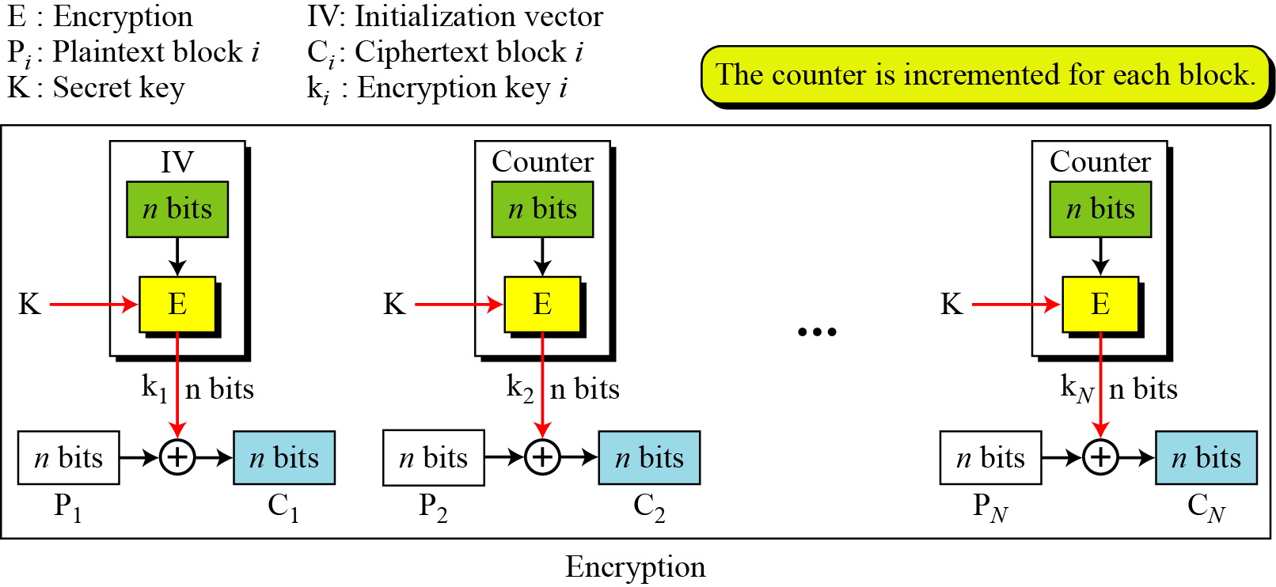
Counter Mode (CTR)

Slide 21
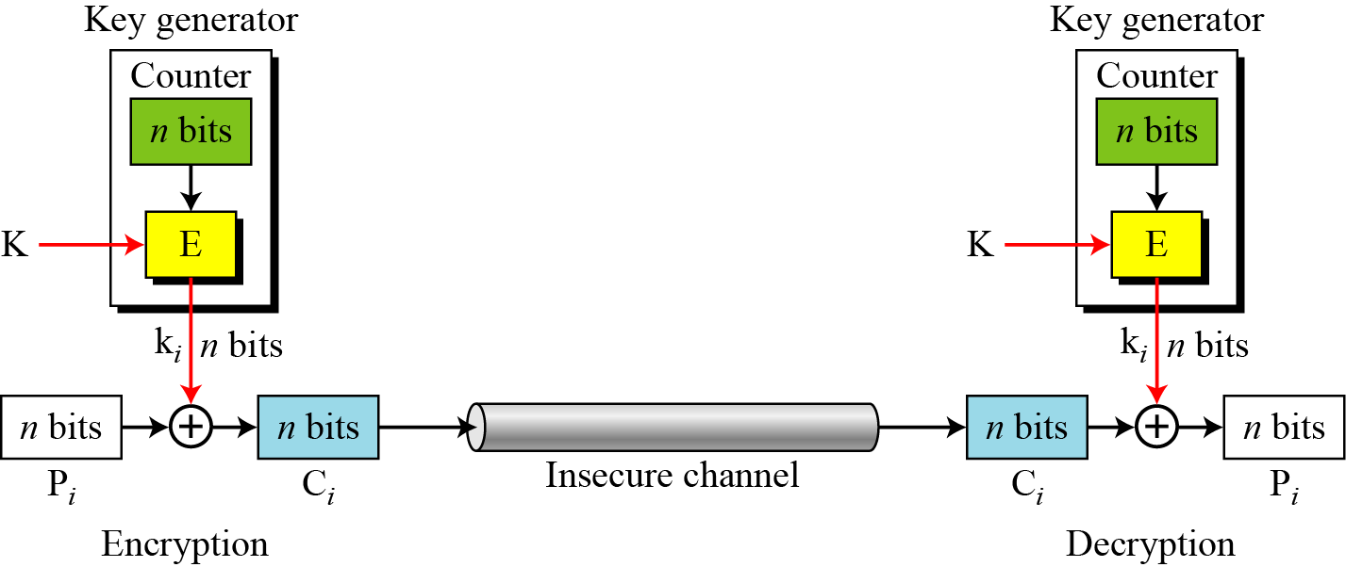
CTR as a Stream Cipher

Slide 22
Security Issues and Error Propagation
The security issues for the CTR mode are the same as the those for OFB mode.
A single error in the ciphertext affects only the corresponding bit in the plaintext.

Slide 23
Comparison

Slide 24
Stream Cipher
RC4
RC4 is a stream cipher that was designed in 1984 by Ronald Rivest for RSA Data Security.
RC4 is used in many data communication and networking protocols, including SSL/TLS and the IEEE802.11 wireless LAN standard.

Slide 25
RC4
RC4 is a byte-oriented stream cipher in which a byte (8 bits) of a plaintext is exclusive-ored with a byte of key to produce a byte of a ciphertext.
State
RC4 is based on the concept of a state.

Slide 26
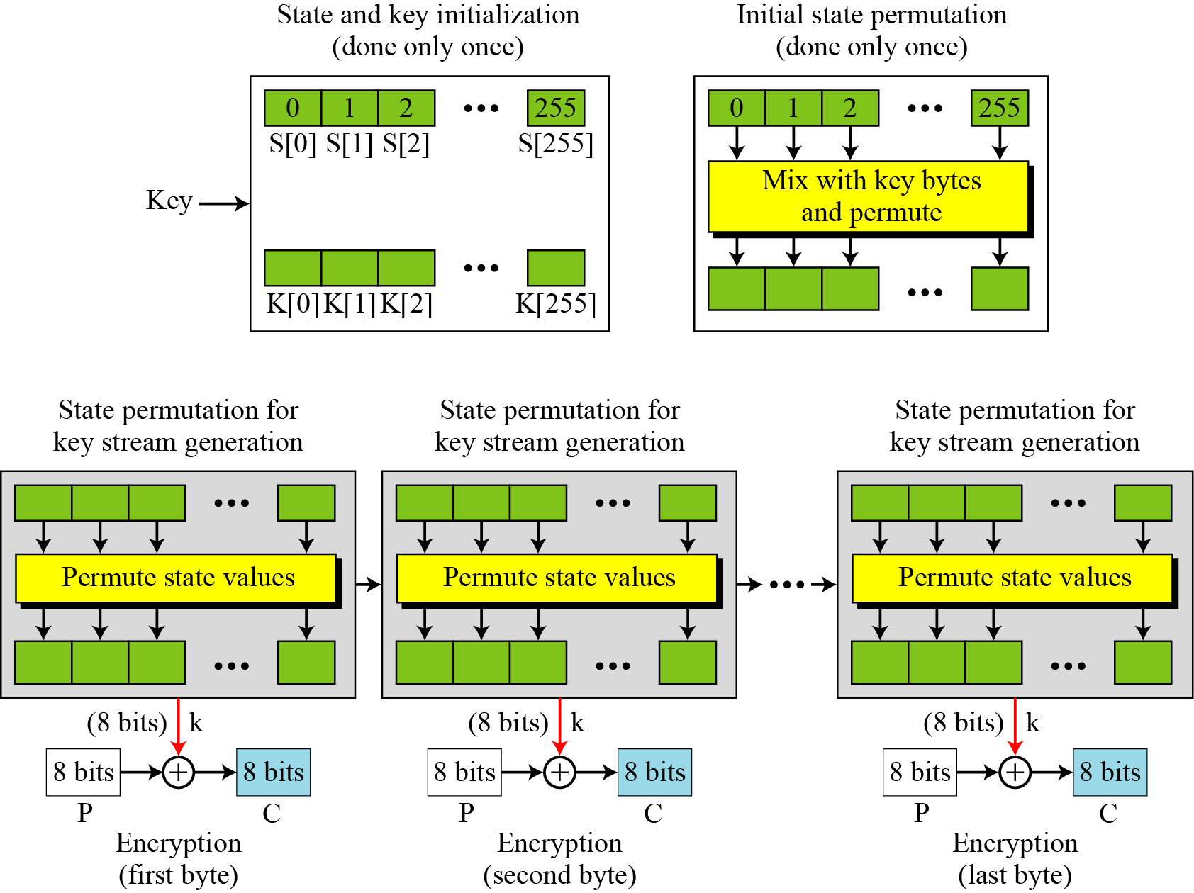
The Idea of RC4

Slide 27
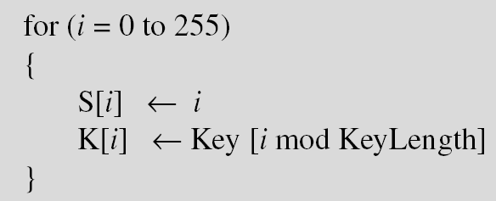
Initialization
Two steps

Slide 28
Key Stream Generation
while (more byte to encrypt)

Slide 29
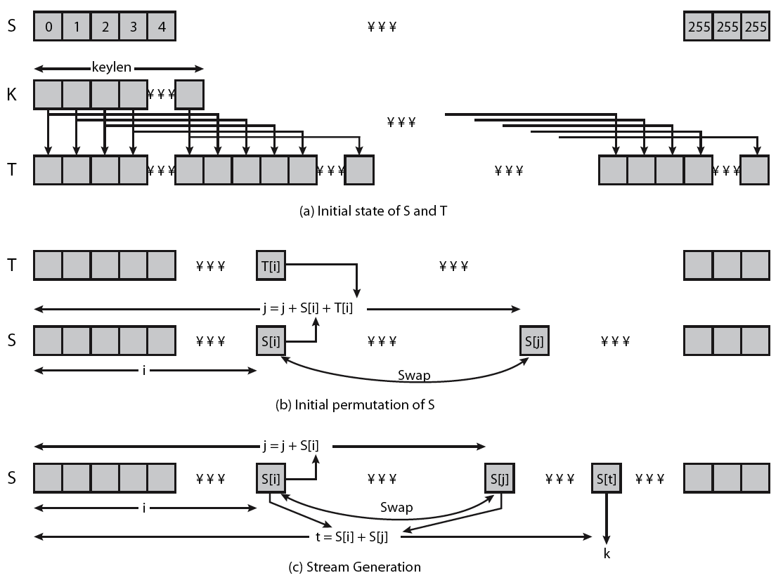
RC4 Overview
Notes:
Stallings Figure 6.9 illustrates the general structure of RC4.

Slide 30
Security Issues
It is believed that the cipher is secure if the key size is at least 128 bits (16 bytes).
There are some reported attacks for smaller key sizes (less than 5 bytes), but the protocols that use RC4 today all use key sizes that make RC4 secure.
However, like many other ciphers, it is recommended the different keys be used for different sessions. This prevents Eve from using differential cryptanalysis on the cipher.

Slide 31
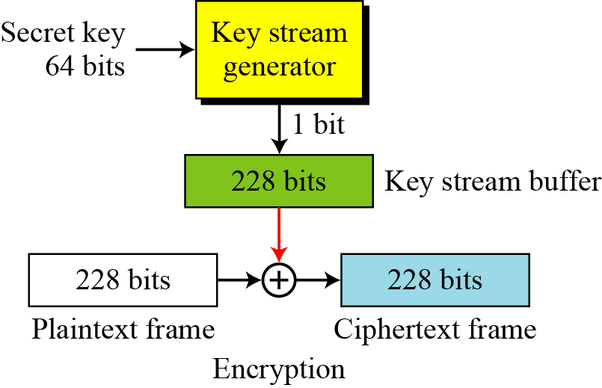
A5/1
A5/1 (a member of the A5 family of ciphers) is used in the Global System for Mobile Communication (GSM), a network for mobile telephone communication.

Slide 32
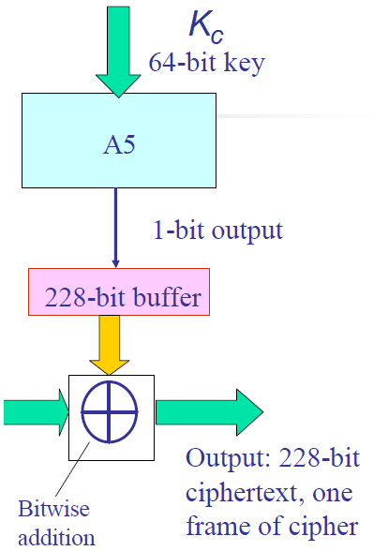
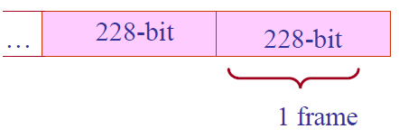
A5/1 and frames
GSM phone conversations: sequences of frames.
One 228 bit = frame is sent in 4.6 milliseconds: 114 bits for the communication in each direction.
A5/1 produces 228 bits to XOR with the plaintext in each frame

Slide 33
LFSR structure
b₁ | b₂ | b₃ | b₄ | ... | b_{n-1} | b_{n}
output
new value
Feedback Function : XOR
A5/1 based on Linear Feedback Shift Registers: LFSRs
Purpose - to produce pseudo random bit sequence
Consists of two parts :
shift register – bit sequence
feedback function
Tap Sequence :
bits that are input to the feedback function

Slide 34
LFSR Features
LFSR Period – the length of the output sequence before it starts repeating itself.
n-bit LFSR can be in 2^{n}-1 internal states
➔ the maximal period is also 2^{n}-1
the tap sequence determines the period
the polynomial formed by a tap sequence plus 1 must be a primitive polynomial (mod 2)
Notes:
What is primitive polynomial?
Boolean polynomial p(x) that can be used to compute the increasing powers of n of x^n mod p(x), to obtain all possible non-zero polynoomials of degree less than p(x)

Slide 35
LFSR Example
Example :
x¹²+x⁶+x⁴+x+1 corresponds to LFSR of length 12
b₁ | b₂ | b₃ | b₄ | b₅ | b₆ | b₇ | b₈ | b₉ | b₁₀ | b₁₁ | b₁₂

Slide 36
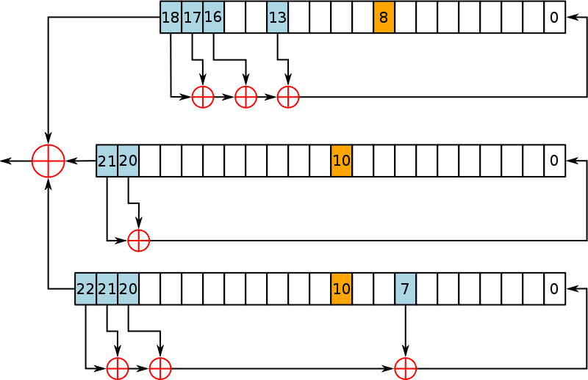
A5/1 LFSRs
Consists of 3 LFSRs of different lengths
19 bits
x¹⁸ + x¹⁷ + x¹⁶ + x¹³ + 1
clock bit 8
tapped bits: 13, 16, 17, 18
22 bits
x²¹ + x²⁰ + 1
clock bit 10
tapped bits 20, 21
23 bits
x²² + x²¹ + x²⁰ + x⁷ + 1
clock bit 10
tapped bits 7, 20, 21, 22
Notes:
Least significant bit numbered 0
Tapped bits of each LSRF are XORed to create value of next 0 bit.
Output bits of the three LSRFs are XORed to form the keystream bit

Slide 37
A5/1 : Operation
All 3 registers are zeroed
64 cycles (without the stop/go clock) :
Each bit of K_{c}(lsb to msb) is XOR'ed in parallel into the lsb's of the registers
22 cycles (without the stop/go clock) :
Each bit of F_{n} (lsb to msb) is XOR'ed in parallel into the lsb's of the registers
100 cycles with the stop/go clock control, discarding the output
228 cycles with the stop/go clock control which produce the output bit sequence.
Notes:
Registers set to all 0’s
Incorporate the key and frame number:
For 64 cycles, the key is mixed in by XORing the ith key bit with the least significant bit of each register
For 22 cycles, the 22 bit frame value is mixed in – same as with key value
Normal clocking used
100 cycles are run using the majority clocking, the output is discarded
End result is the initial state

Slide 38
Initialization
Set all bits in three LFSRs to 0.

Slide 39
A5/1 working example
18
17
16
0
0 | 1 | 1 | 1 | 1 | 0 | 1 | 1 | 0 | 1 | 0 | 1 | 1 | 0 | 1 | 0 | 1 | 0
1
1 | 1 | 1 | 1 | 0 | 1 | 1 | 0 | 1 | 0 | 1 | 1 | 0 | 1 | 0 | 1 | 0 | 1
1 | 0 | 1 | 1 | 1 | 1 | 0 | 1 | 1 | 0 | 1 | 0 | 1 | 1 | 0 | 1 | 0 | 1 | 0
0
R1
C1
1
0
clock
control
21
20
0
1 | 0 | 1 | 1 | 1 | 0 | 0 | 1 | 0 | 0 | 1 | 0 | 1 | 0 | 1 | 0 | 1 | 1 | 1 | 0 | 0 | 1
1
1
1
0 | 1 | 1 | 1 | 0 | 0 | 1 | 0 | 0 | 1 | 0 | 1 | 0 | 1 | 0 | 1 | 1 | 1 | 0 | 0 | 1
R2
C2
1
22
21
20
0
0 | 1 | 0 | 1 | 0 | 1 | 0 | 0 | 1 | 1 | 0 | 1 | 1 | 1 | 0 | 1 | 1 | 0 | 0 | 1 | 0 | 1
1 | 0 | 1 | 0 | 1 | 0 | 1 | 0 | 0 | 1 | 1 | 0 | 1 | 1 | 1 | 0 | 1 | 1 | 0 | 0 | 1 | 0 | 1
0
R3
C3
0

Slide 40
Security of A5/1
As leakage from the algorithm many cryptanalysis works are performed.
Known-plaintext attacks
Directly to the GSM networks

Slide 41
Knapsack Encryption Algorithm

Slide 42
Knapsack Encryption Algorithm is the first general public key cryptography algorithm. It is developed by Ralph Merkle and Mertin Hellman in 1978. As it is a Public key cryptography, it needs two different keys. One is Public key which is used for Encryption process and the other one is Private key which is used for Decryption process. In this algorithm we will two different knapsack problems in which one is easy and other one is hard. The easy knapsack is used as the private key and the hard knapsack is used as the public key. The easy knapsack is used to derived the hard knapsack.

Slide 43
For the easy knapsack, we will choose a Super Increasing knapsack problem. Super increasing knapsack is a sequence in which every next term is greater than the sum of all preceding terms.
{1, 2, 4, 10, 20, 40}
is a super increasing as
1<2, 1+2<4, 1+2+4<10, 1+2+4+10<20 and 1+2+4+10+20<40.

Slide 44
Derive the Public key
Step-1: Choose a super increasing knapsack {1, 2, 4, 10, 20, 40} as the private key.
Step-2: Choose two numbers n and m. Multiply all the values of private key by the number n and then find modulo m. The value of m must be greater then the sum of all values in private key, for example 110. And the number n should have no common factor with m, for example 31.
Step-3: Calculate the values of Public key using m and n.

Slide 45
1x31 mod(110) = 31
2x31 mod(110) = 62
4x31 mod(110) = 14
10x31 mod(110) = 90
20x31 mod(110) = 70
40x31 mod(110) = 30
Thus, our public key is {31, 62, 14, 90, 70, 30} And Private key is {1, 2, 4, 10, 20, 40}.

Slide 46
Example – Lets our plain text is 100100111100101110.
1. Encryption : As our knapsacks contain six values, so we will split our plain text in a groups of six:
100100 111100 101110
Multiply each values of public key with the corresponding values of each group and take their sum.
100100 {31, 62, 14, 90, 70, 30}
1x31+0x62+0x14+1x90+0x70+0x30 = 121
111100 {31, 62, 14, 90, 70, 30}
1x31+1x62+1x14+1x90+0x70+0x30 = 197
101110 {31, 62, 14, 90, 70, 30}
1x31+0x62+1x14+1x90+1x70+0x30 = 205
So, our cipher text is 121 197 205

Slide 47
2. Decryption :
The receiver receive the cipher text which has to be decrypt. The receiver also knows the values of m and n.
So, first we need to find the n^-1, which is multiplicative inverse of n mod m i.e.,
n x n^-1 mod(m) = 1
31 xn^-1 mod(110) = 1
n^-1 = 71
Now, we have to multiply 71 with each block of cipher text take modulo m.
121 x 71 mod(110) = 11
Then, we will have to make the sum of 11 from the values of private key {1, 2, 4, 10, 20, 40} i.e.,
1+10=11 so make that corresponding bits 1 and others 0 which is 100100.
Similarly,
197 x 71 mod(110) = 17
1+2+4+10=17 = 111100
And, 205 x 71 mod(110) = 35
1+4+10+20=35 = 101110

Slide 48
ElGamal Encryption Algorithm

Slide 49
ElGamal encryption
ElGamal encryption is an public-key cryptosystem. It uses asymmetric key encryption for communicating between two parties and encrypting the message. This cryptosystem is based on the difficulty of finding discrete logarithm in a cyclic group that is even if we know gª and g^{k}, it is extremely difficult to compute g^{ak}.

Slide 50
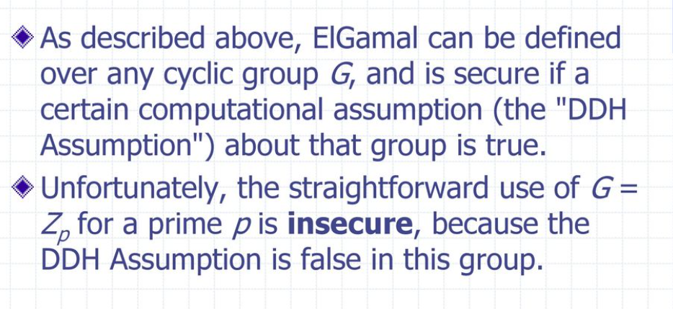

Slide 51
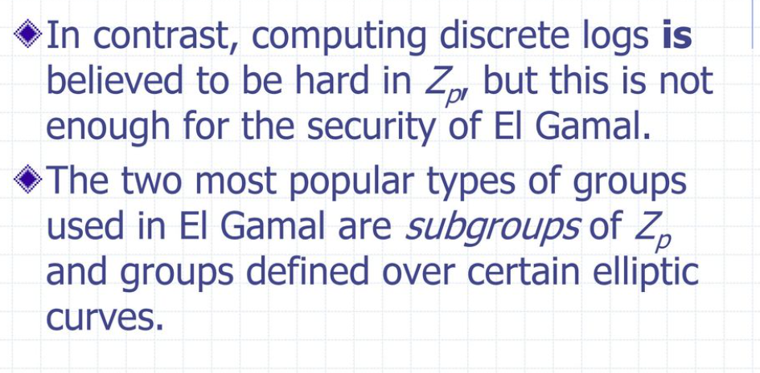

Slide 52
Idea of ElGamal cryptosystem
Suppose Alice wants to communicate to Bob.
Bob generates public and private key :
Bob chooses a very large number q and a cyclic group F_{q}.
From the cyclic group F_{q}, he choose any element g and an element a such that gcd(a, q) = 1.
Then he computes h = gª.
Bob publishes F, h = gª, q and g as his public key and retains a as private key.
Alice encrypts data using Bob’s public key :
Alice selects an element k from cyclic group F such that gcd(k, q) = 1.
Then she computes p = g^{k} and s = h^{k} = g^{ak.}
She multiples s with M.
Then she sends (p, M*s) = (g^{k}, M*s).
Bob decrypts the message :
Bob calculates s′ = pª = g^{ak}.
He divides M*s by s′ to obtain M as s = s′.

